Slide 1


NewsBot Intelligence System
ITAI 2373 – Midterm Project
Lufei Yu & Richard Cortez
April 1, 2026

Slide 2

Project Overview
What Our System Does
Cleans and preprocesses raw news text
Extracts TF‑IDF features
Performs POS tagging
Conducts sentiment & emotion analysis
Supports classification
Generates business intelligence insights
Notes:
Explain that the system follows a complete NLP workflow.

Slide 3
Real‑World Applications
Industries & Use Cases
Media monitoring
Business intelligence
Market research
Content management
Crisis detection
Brand reputation tracking
Notes:
Highlight how organizations use NLP to understand public sentiment and trends.

Slide 4
Dataset Overview
Dataset Summary
Total articles: 10
Categories: 5
Balanced distribution
Unique sources: 10
Date range: 2024‑01‑15
Notes:
Mention that this is a sample dataset but the pipeline is scalable.

Slide 5

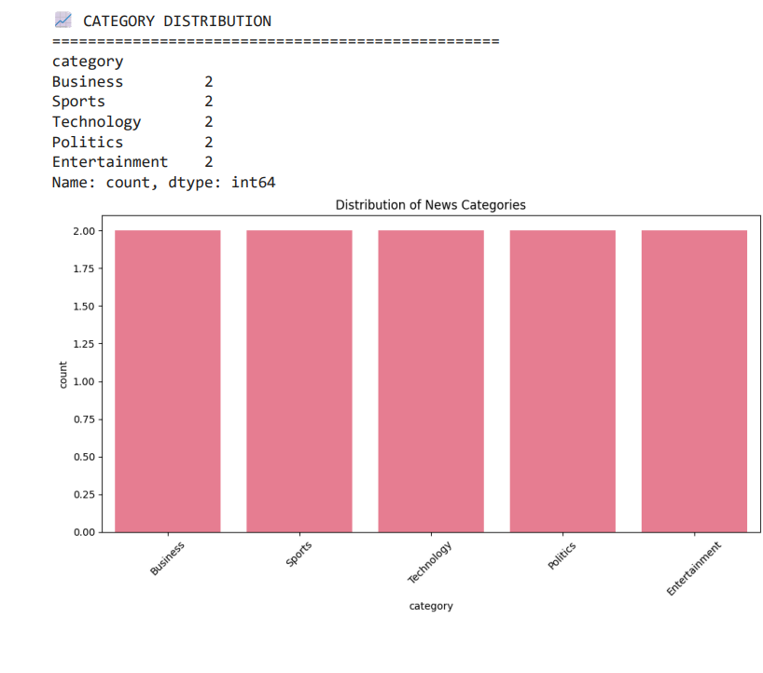



Category Distribution
Notes:
Explain that balanced categories help avoid model bias.

Slide 6
Text Preprocessing Pipeline
Steps Implemented
HTML removal
URL & email removal
Lowercasing
Special character filtering
Tokenization
Stopword removal
Lemmatization
Short‑word filtering
Notes:
Preprocessing improves model accuracy and reduces noise.

Slide 7
Before & After Example
Original Text: “Apple Inc. announced record quarterly earnings today…”
Processed Text: “apple inc announced record quarterly earnings today visit info technews”
Notes:
Show how the text becomes standardized and machine‑friendly.

Slide 8
TF‑IDF Feature Extraction
Vectorizer Settings
max_features = 5000
ngram_range = (1,2)
min_df = 2
max_df = 0.8
Results
Matrix shape: 10 × 4
Vocabulary size: 4
Sparsity: 77.5%
Notes:
Explain how TF‑IDF identifies important terms.

Slide 9
Top TF‑IDF Terms by Category
Examples
Business: growth, strong
Technology: new, promise
Entertainment: new, growth
Notes:
Discuss how different categories emphasize different keywords.

Slide 10
TF‑IDF Visuals
Recommended Visuals
Word clouds
Bar charts
Heatmap of term importance
Notes:
These visuals help stakeholders quickly understand topic emphasis.

Slide 11
POS Tagging & Grammar Analysis
What We Analyzed
Nouns
Verbs
Adjectives
Adverbs
Numbers
Notes:
POS tagging reveals writing style differences.

Slide 12
POS Patterns by Category
Insert Visual: Heatmap of POS proportions
Key Findings
Proper nouns dominate
Sports uses more action verbs
Technology uses more adjectives
Notes:
Explain how grammar varies by category.

Slide 13
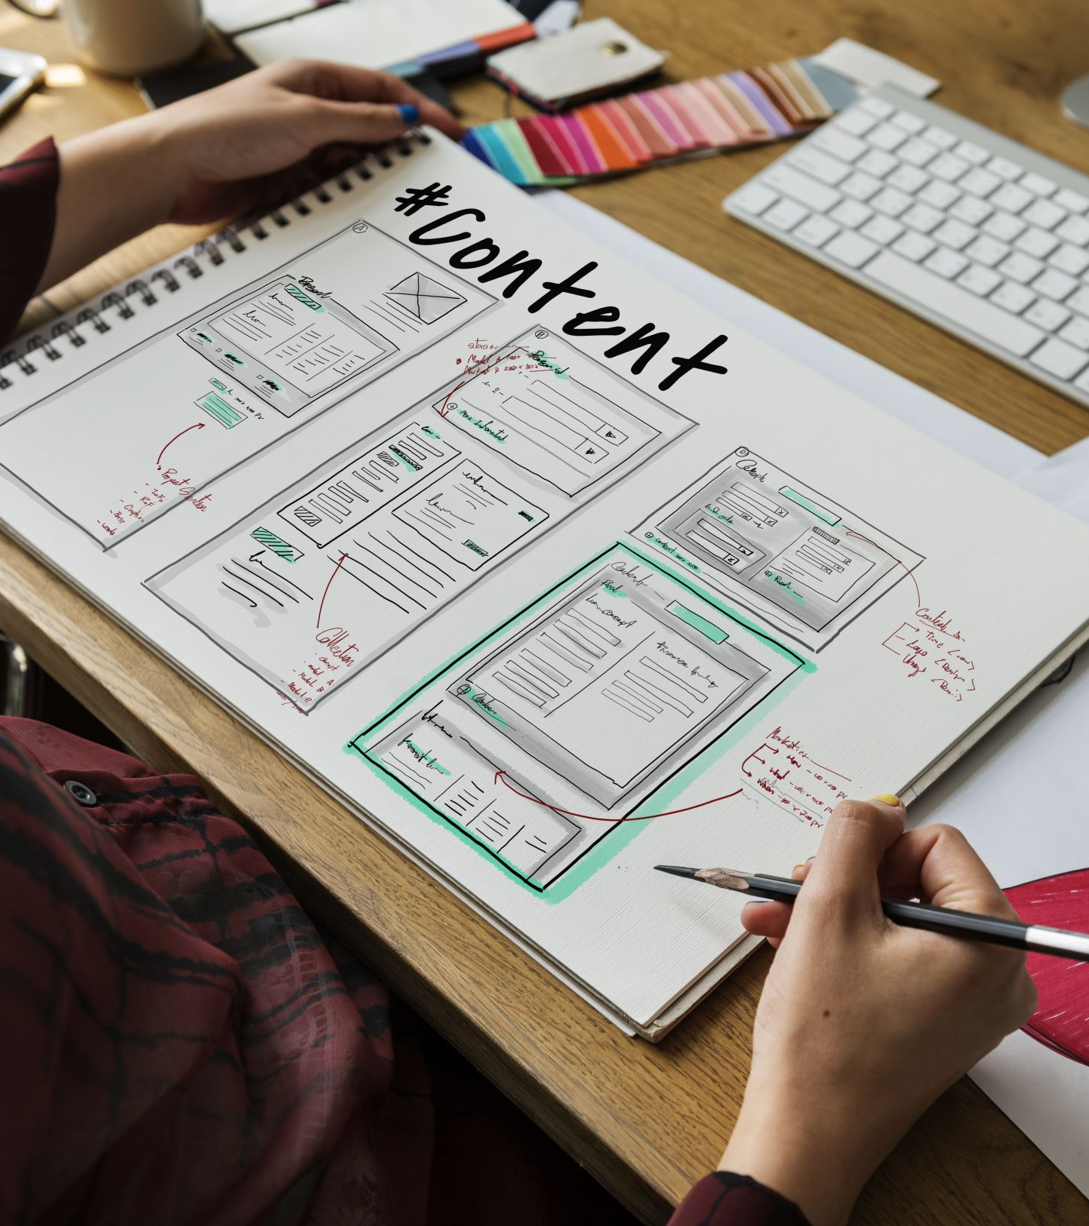
Sentiment & Emotion Analysis
System Capabilities
VADER sentiment scoring
Emotion lexicon integration
Tone analysis
Notes:
Sentiment helps understand public perception of topics.

Slide 14
Business Intelligence Insights
Insights Enabled
Trending topics
Sentiment toward companies
Keyword importance
Entity extraction
Writing style differences
Notes:
Tie NLP outputs to real business value.

Slide 15
Conclusion & Future Work
Key Takeaways
Built a complete NLP workflow
Preprocessing → TF‑IDF → POS → Sentiment → Insights
Future Enhancements
Larger dataset
Deep learning models (BERT)
Topic modeling
Real‑time ingestion
Dashboard visualization
Notes:
Summarize the project and highlight next steps.

